Slide 1


Promise with : $q

Slide 2
Promises
What is a promise?
The Promise object is used for asynchronous computations. A Promise represents a value which may be available now, or in the future, or never.
A Promise is in one of these states:
pending: initial state, not fulfilled or rejected.
fulfilled: meaning that the operation completed successfully.
rejected: meaning that the operation failed.
Promises are good for handling asynchronous operations:
Wait for a large file to load
Wait for a server to respond
Wait for a user to confirm or abort an operation
…

Slide 3
Promises
Deferred vs promise
Deferred :
Must be kept private
Implement resolve(), reject() & notify()
Expose the Promise
Promise :
Can be shared to allow access to result
Implement then(), catch(), finally()
“Read only version” of a Deferred
Naming and functionalities may vary depending of implementations (Native JS, jQuery, Q, $q)

Slide 4
Promises
Angular $q
A service that helps you run functions asynchronously
defer();
Creates a Deferred object which represents a task which will finish in the future
all(promises);
Combines multiple promises into a single promise that is resolved when all of the input promises are resolved.
race(promises);
Returns a promise that resolves or rejects as soon as one of those promises resolves or rejects, with the value or reason from that promise.

Slide 5
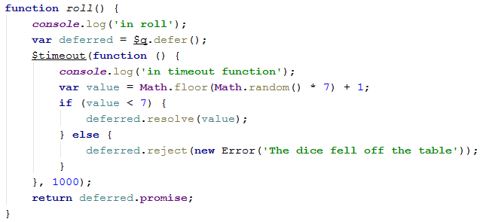
Promises
creating a promise

Slide 6
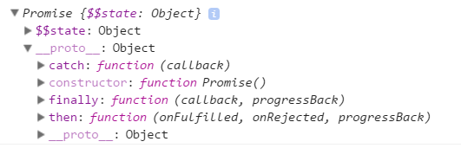

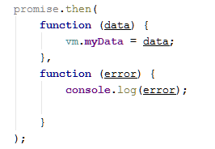
Promises
Available mehods =>
Using a promise :
A little better !
see next slide for top of the top !

Slide 7

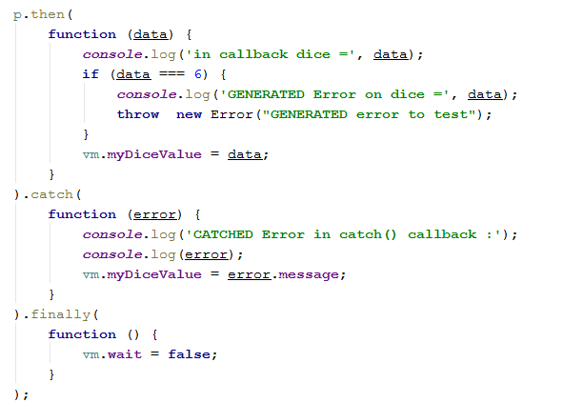
Promises
SOLUTION for catching ALL error(s) even those happening inside the callbacks

Slide 8
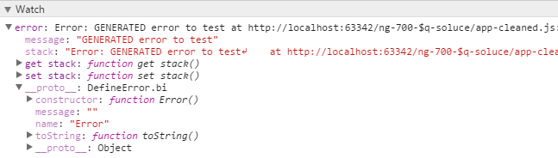

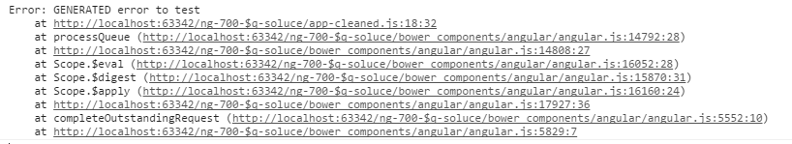
Promises
catching all error(s) even those happening inside the callbacks

